Slide 1
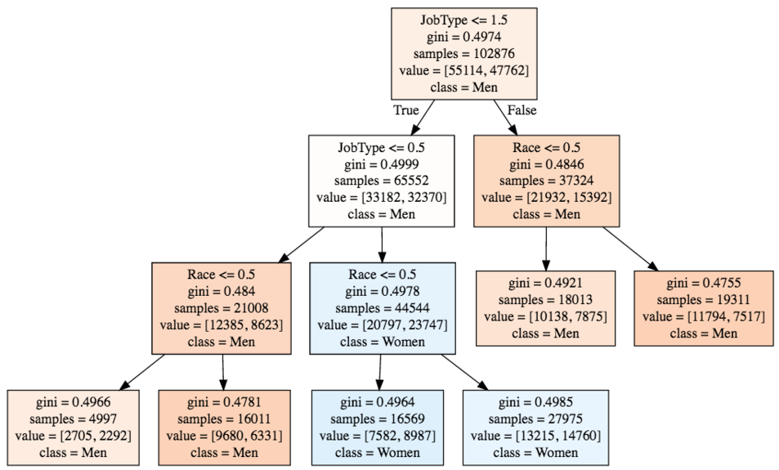
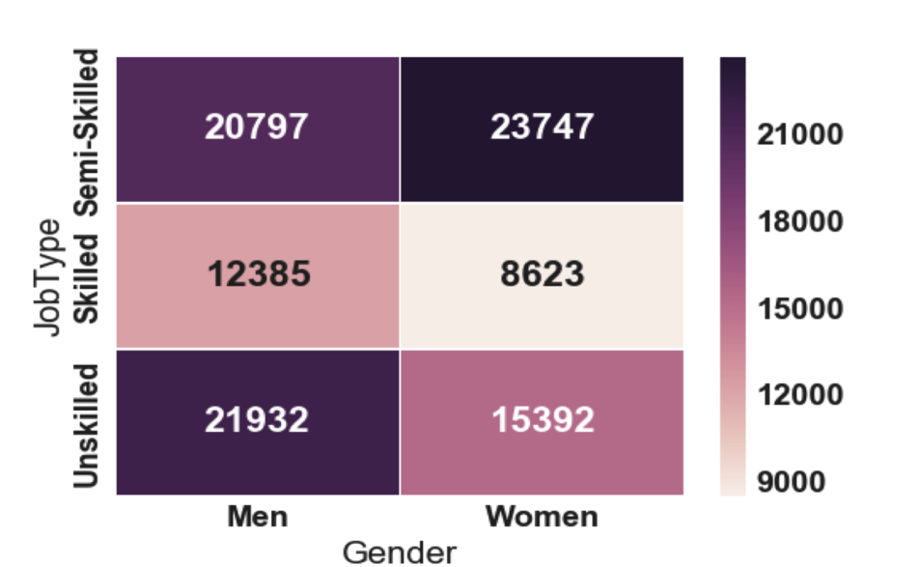
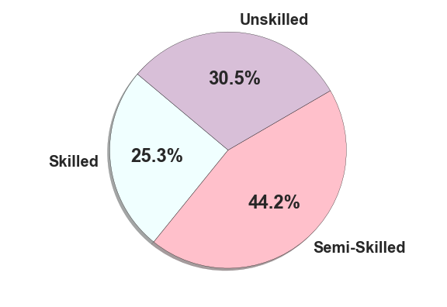
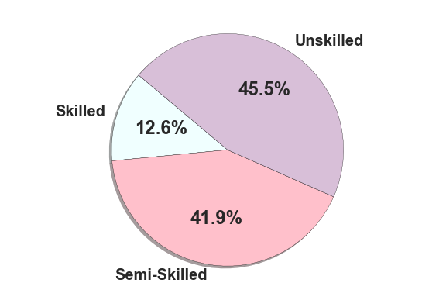
Inequality in Private Industry
Goal
Methods
With the recent rise of gender and racial equality campaigns, greater exposure has been given to the inequality that exists among women and minorities. Through this project, we wanted to determine whether there was a disparity among job patterns for men, women, and people of different races.
Dataset
This dataset comes from the U.S. Equal Employment Opportunity Commision and is a collection of employment statistics that show the percentage of men, women, and minorities in different careers and different job categories from 1996 to 2015. In order to expose inequality within the workforce, we discretized job categories by the level of skill required to hold that job (i.e. officials & managers, professionals, and technicians became skilled; sales, office & clerical, and operatives became semi-skilled; and service workers, laborers, craft Workers became unskilled). We chose to look at years 2007 through 2015 for our initial Linear Regression and discovered the year would have no influence on our predictions. From there, we arbitrarily chose two years to work with (2007 and 2015) to lessen the computational load.
Gender Decision Tree by Race and Job Type
Analysis
Job Type Distribution by Gender
Conclusion
White Worker Distribution
Minority Worker Distribution

